Slide 1
Introduction to K2E Devices New members of the keystone II family

Slide 2
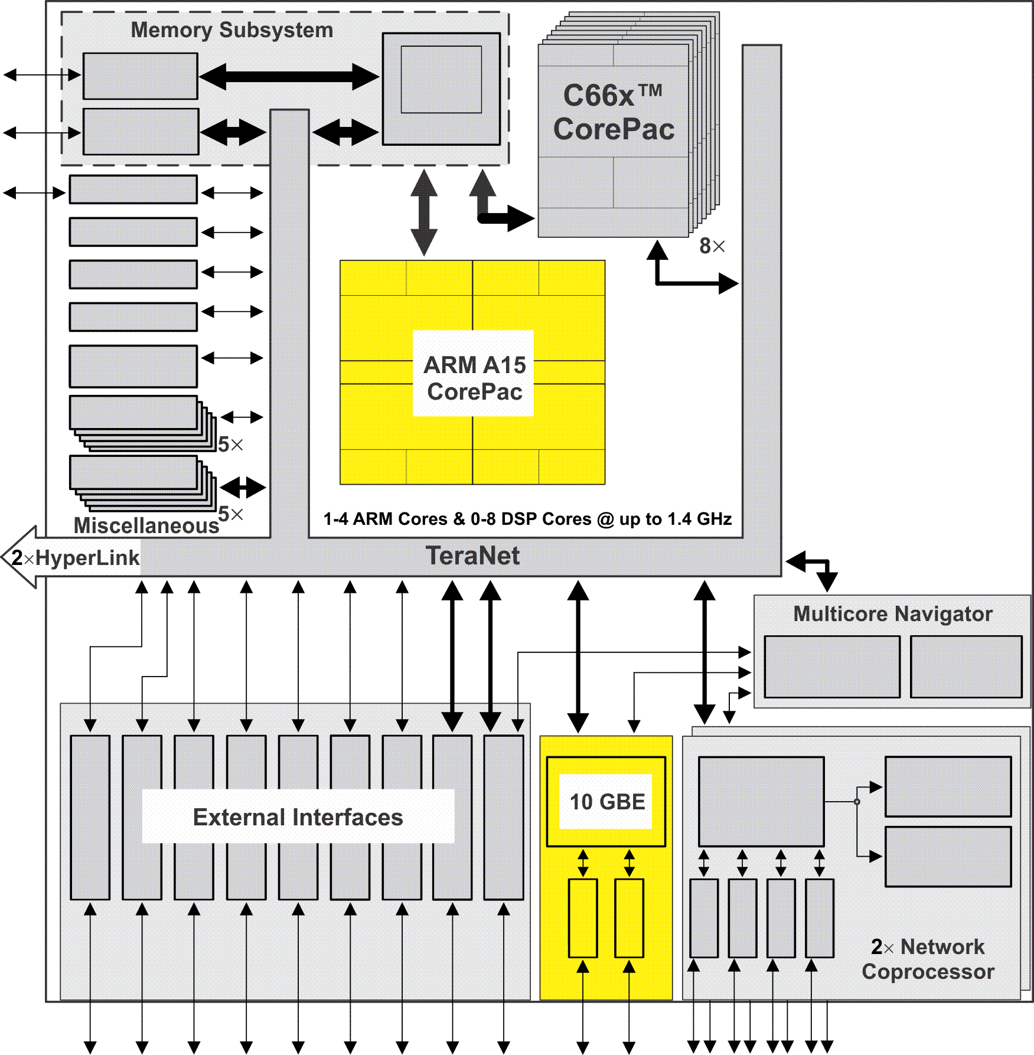
Keystone II Architecture
Strong Core Performances
Memory Sub-system –
Multi-banks shared memory
32 to 36 (40) bit translation
Smart access arbitration
Memory protection EDC
Multicore Navigator
Hardware routing
NetCP
Hardware Accelerators
High bit rate peripherals
SRIO, PCIe, Ethernet, TSIP
Teranet –
Non blocking
Smart arbitration
Fast and wide
Hyperlink
Seamless interface
Lot’s of connectivity

Slide 3
Keystone I Architecture
Application-Specific
High end of the market for signal
processing
Amazing performances
Great SOC features
But
Power consumption 10-15W
Prices reflect the performances
Low-end devices –
The Gauss family
Memory Subsystem
Coprocessors
C66x™
CorePac
Miscellaneous
HyperLink
TeraNet
Multicore Navigator
External Interfaces
Network Coprocessor

Slide 4
Keystone I Gauss Family
Memory Subsystem
1MB
C6655/57
Signal Processing Engine
Few, more generic, accelerators
No NetCP
No TSIP but McBSP
Smaller, slower DDR, less pins
Maintain most of Keystone
Family advantages
32-Bit
MSM
DDR3 EMIF
SRAM
MSMC
Debug/Trace
Boot ROM
2nd core, C6657 only
Semaphore
Timers
C66x™
Security /
CorePac
Key Manager
Coprocessors
Power
Management
32KB L1P
32KB L1D
TCP3d
PLL
Cache/RAM
Cache/RAM
x2
1024KB L2 Cache
VCP2
x2
EDMA
1 or 2 Cores @ up to 1.25 GHz
HyperLink
TeraNet
Multicore Navigator
Typical Usage
Low power project –
Sealed box, power limitations
Projects that need performances
But 2 cores is enough
Projects that do not need the
Accelerators or TSIP
Projects that need smaller DDR
Queue
Packet
Manager
DMA
x2
x2
x2
x4
O
P
T
I
Ethernet
I
P
O
MAC
EMIF16
P
I²C
R
P
e
I
G
U
A
S
McBSP
I
U
C
R
P
S
SGMII

Slide 6
Embedded Processing offering

Slide 7
K2E Arrives

Slide 8
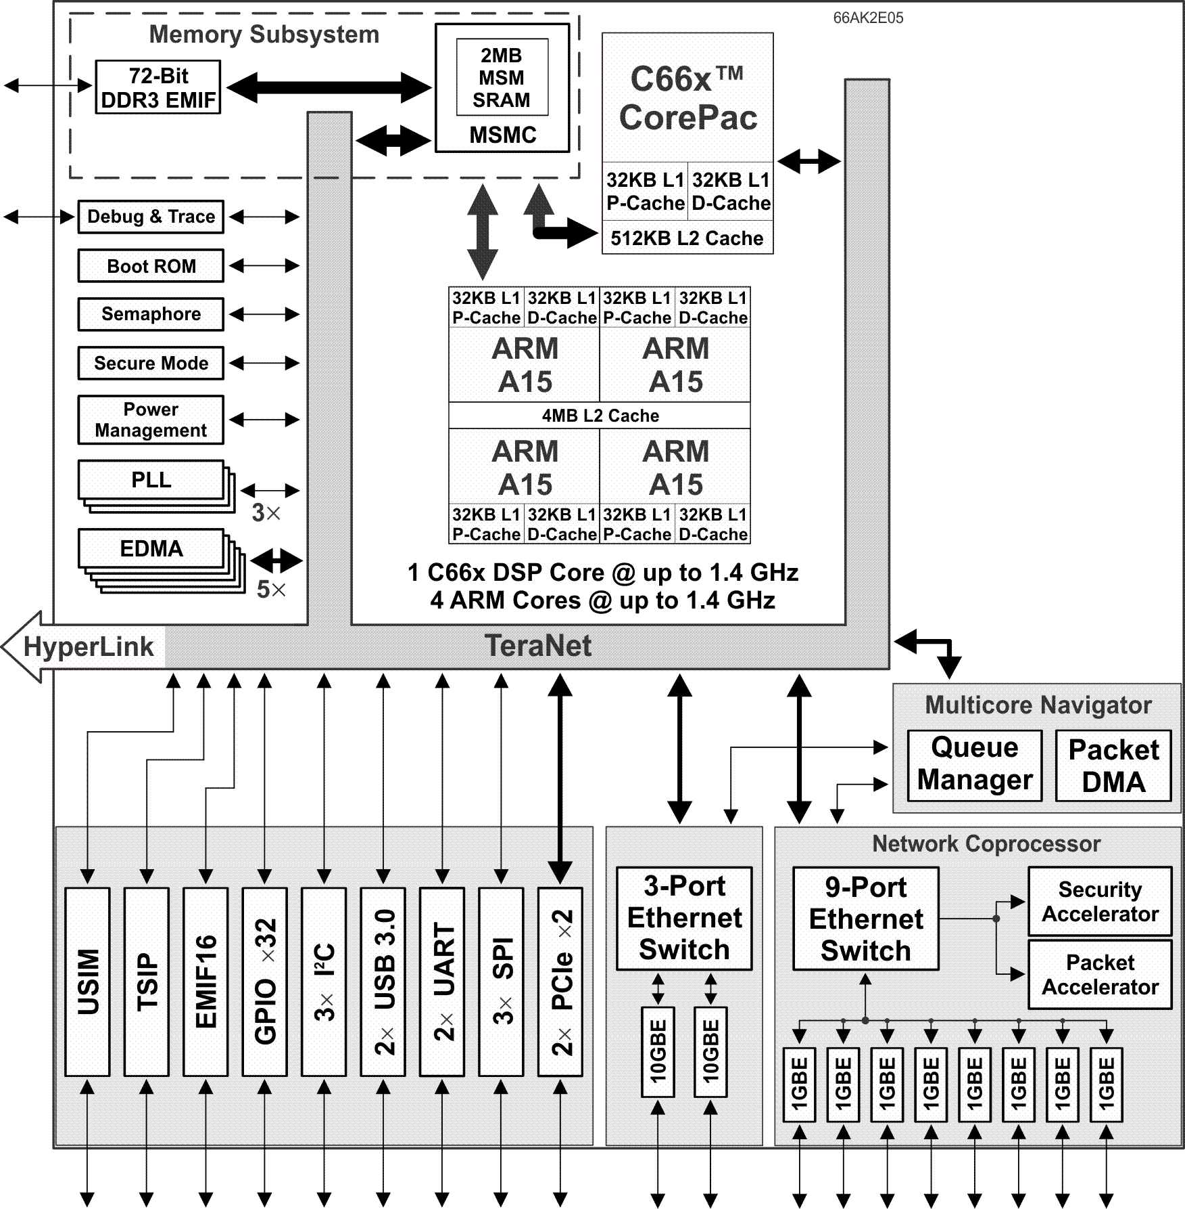
66AK2E05
Powerful micro-computer with DSP co-processor
10 Ethernet ports, 2x10G, 8x1G
2x PCIe
2x USB
Notes:
8
NEW

Slide 9
66AK2E05 Applications
Communication and network
Storage – fast hard disk (PCIe, USB)
Imaging – including analytic
Example - Defense communication system
Advantages
Integrate solution – SOC
High communication Speed and disk bandwidth to store data
DSP enables data processing on the fly
Ability to scale up using hyperlink, scale down using 66AK2E02
Low power (compare to other solutions)
Notes:
9
NEW

Slide 10
Embedded Processing offering

Slide 11
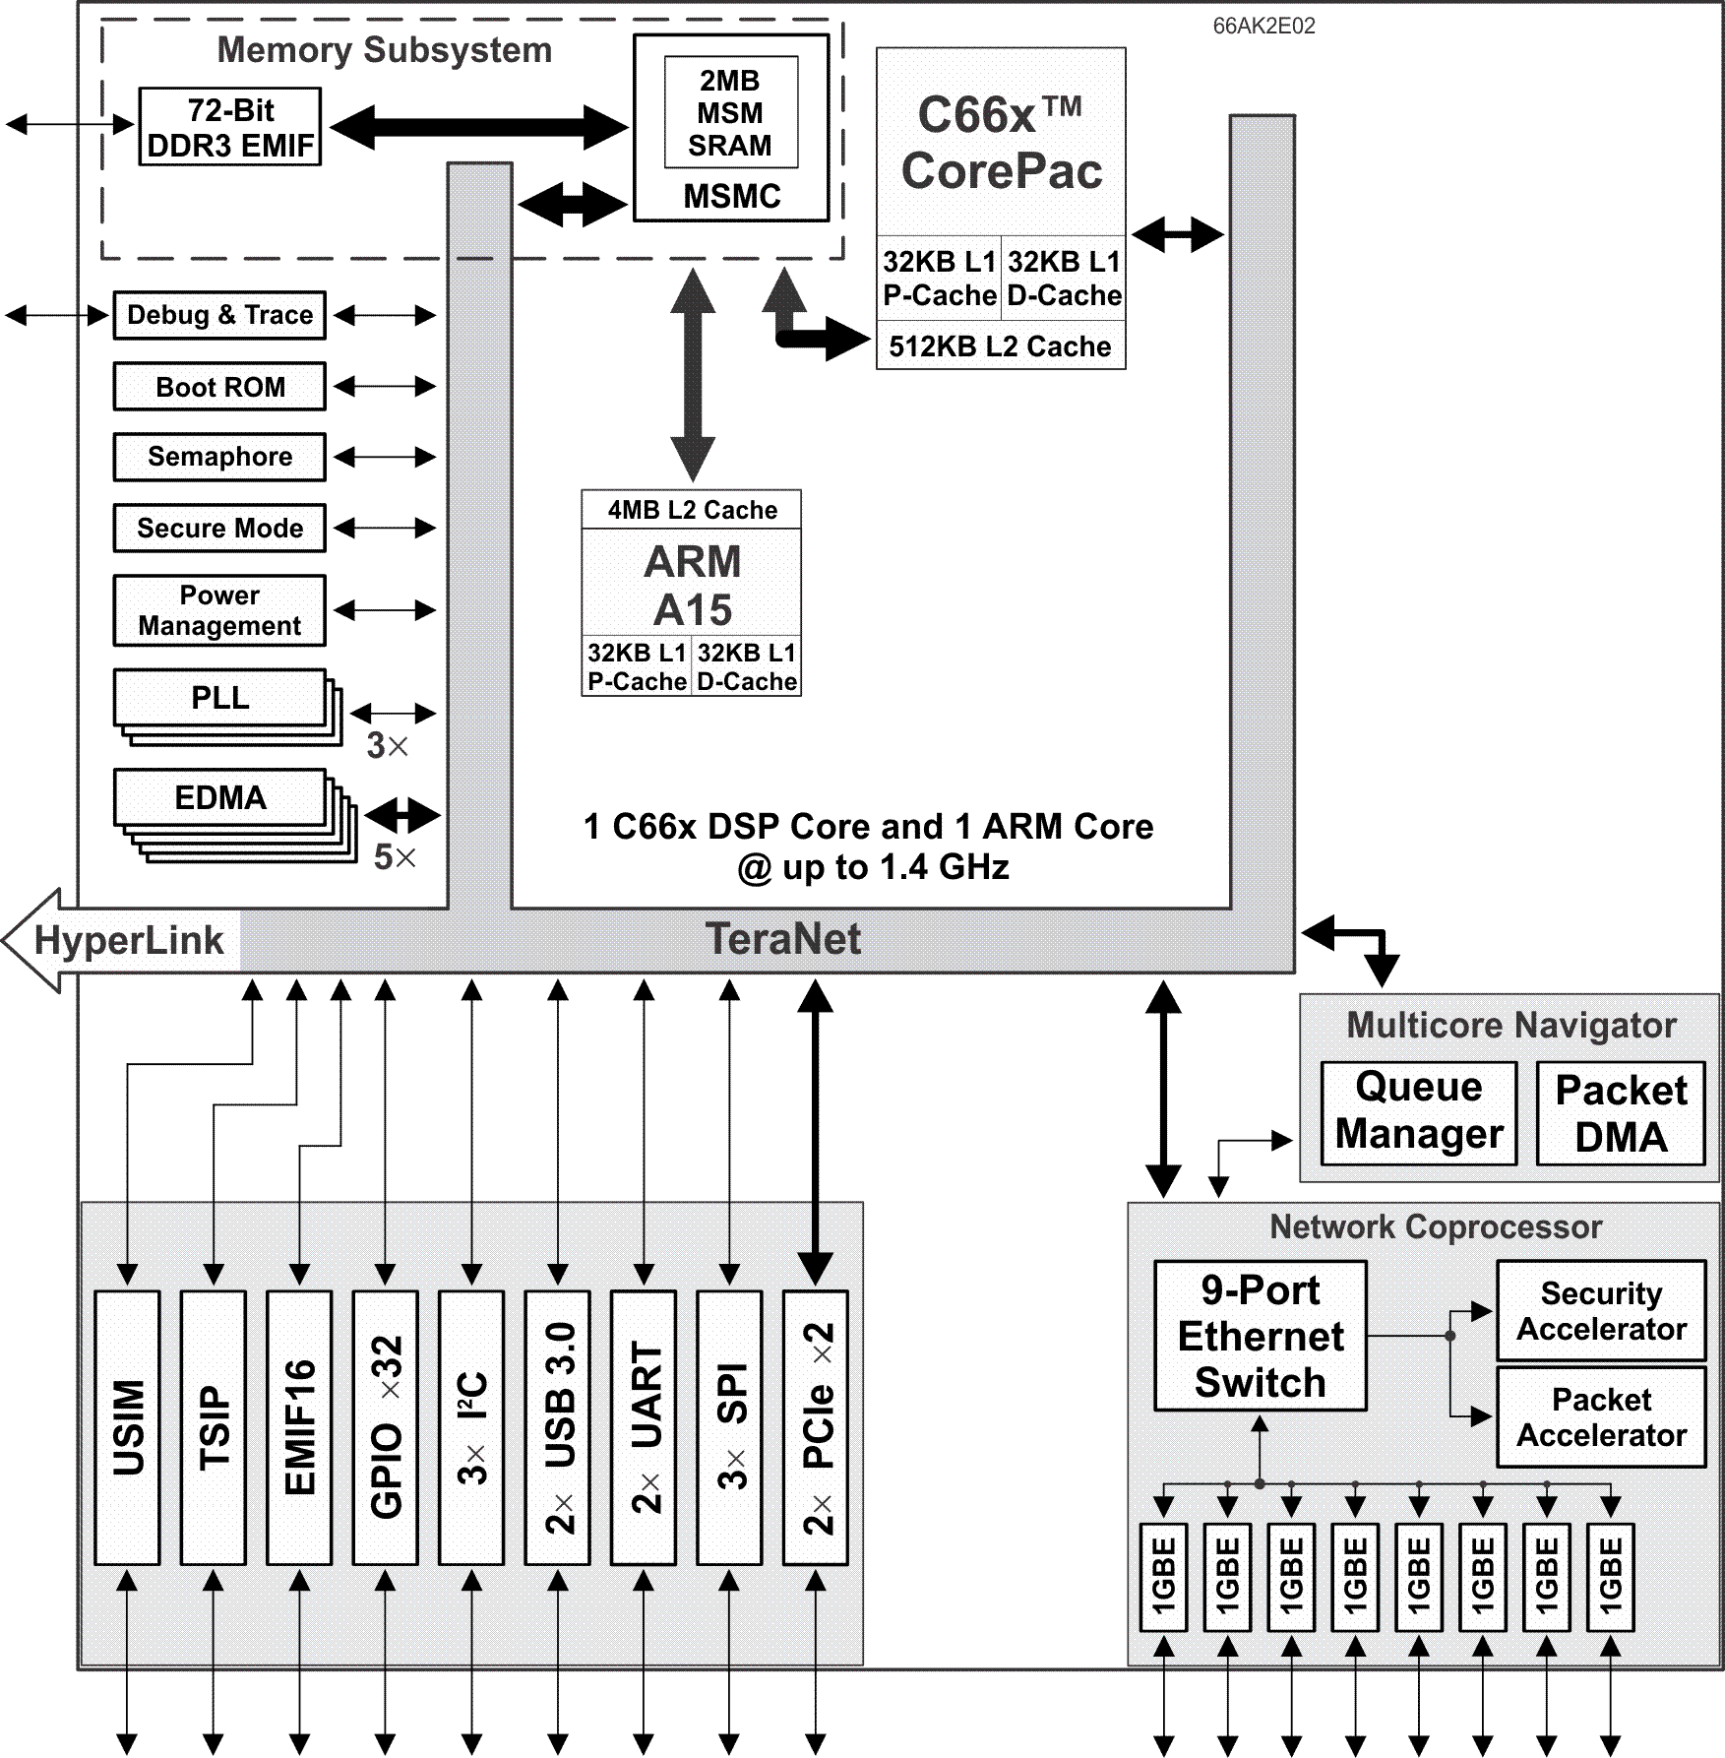
66AK2E02
Scaled-down version of 66AK2E05
High connectivity but does not have 10G
2xPCIe and 2x USB enables fast disk storage
Communication, storage with some analytics
Notes:
11
NEW

Slide 12
66AK2E02 Applications
Smart Grid and Smart Metering
Factory Automation
Building Control
Aerospace and Defense
Industrial Network and Field Bus Protocols
Medical Imaging
Notes:
12
NEW

Slide 13
Embedded Processing offering

Slide 14
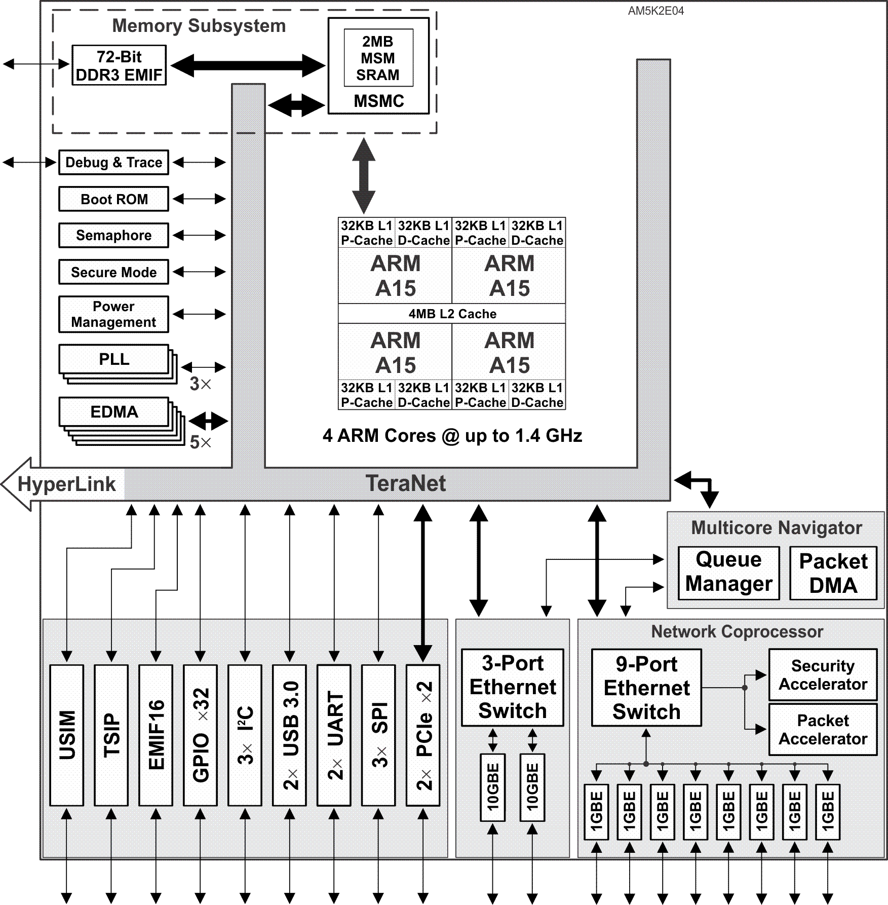
AM5K2E04
ARM-only TI multicore device
Quad-ARM A15 CorePac
1x Queue Manager supports up to 8K queues
1x Network Coprocessors (NETCP)
1x 3 port 10GBE Switch Subsystem
Telecommunications Serial Port (TSIP)
PCIe and 2x USB 3.0 to support solid state drive
Notes:
14
NEW

Slide 15
AM5K2E04 Applications
Networking
Enterprise
Service Provider
Data Center/Cloud
Industrial Network and Field Bus Protocols
Other industrial applications that do not require DSP
Notes:
15
NEW

Slide 16
AM5K2E04 Win
Defense Munition project
AM5K2E04 provides:
power efficient
high performance processor.
large amount of internal memory
Efficient ARM instructions
Notes:
16
NEW

Slide 17
AM5K2E04 Win
Flight Control Panel
AM5K2E04 provides:
high performance Linux based processor
Efficient memory and internal bus utilization (MSMC, Teranet)
Open source applications available
Support for Big endian
Notes:
17
NEW

Slide 18
Embedded Processing offering

Slide 19
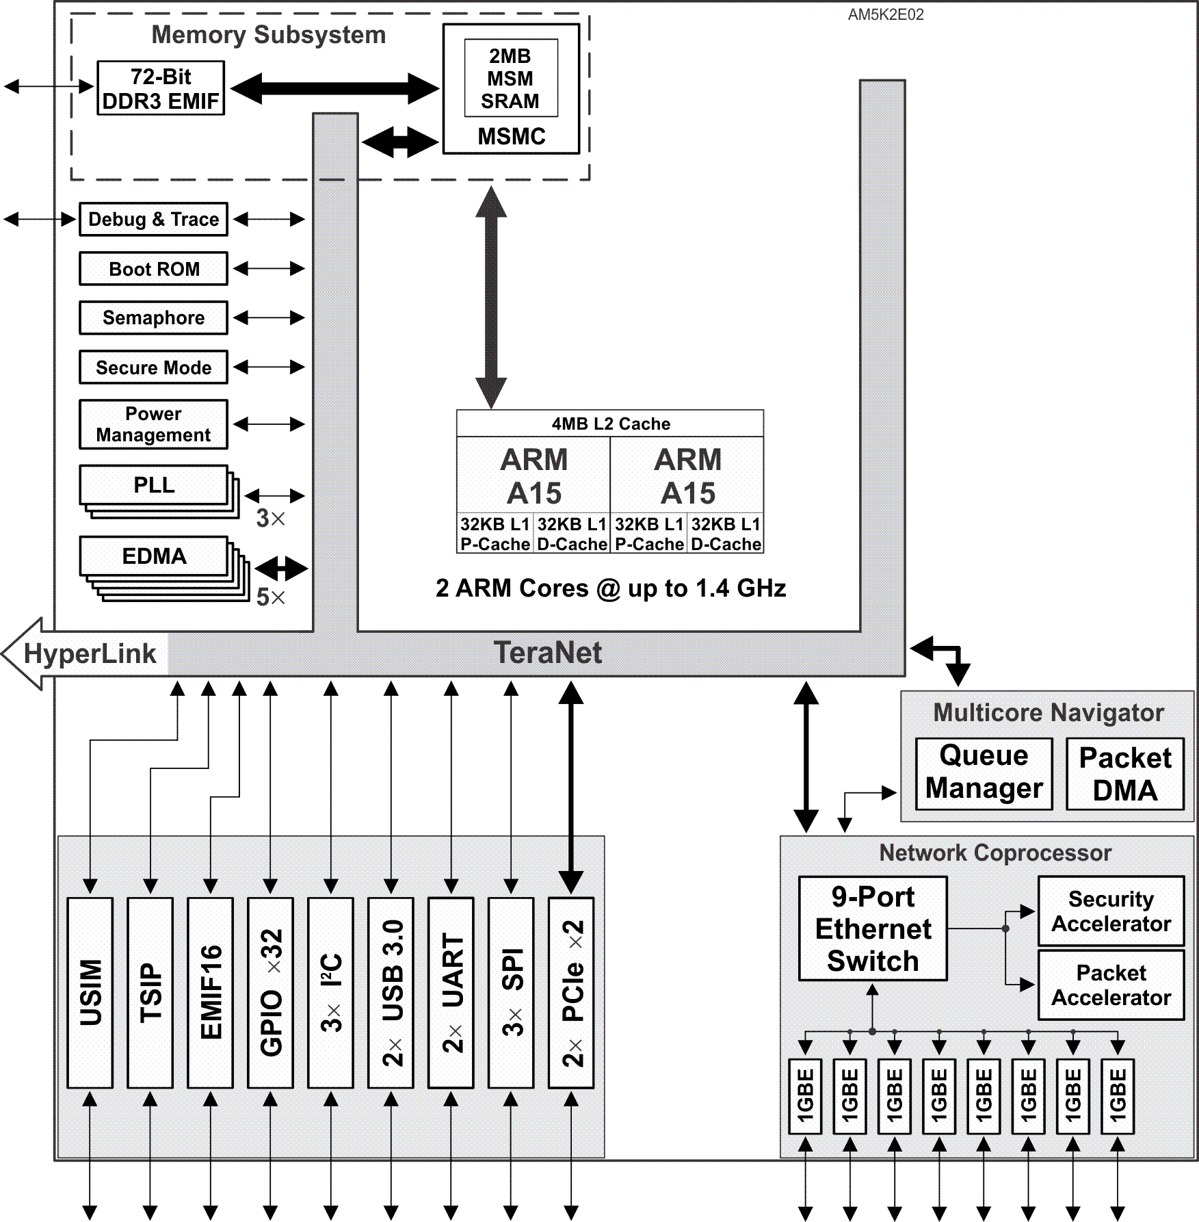
AM5K2E02
Scaled-down version of AM5K2E04
Dual-ARM A15 CorePac
1x Network Coprocessor
10GBE not included
Applications
Low-end applications of AM5K2E04
Notes:
19
NEW

Slide 20
Embedded Processing offering

Slide 21
K2E Devices Summary

Slide 22
K2h and K2E Architecture compare
 | K2H | K2E
DSP Cores | Up to 8 | 1 or 0
DSP maximum clock | 1.2G | 1.4G
External Memory | DDRA and DDRB | DDRA only
MSMC memory (shared L2) | 6 MB | 2 MB
PLL | 5 | 3
SRIO | 4 lanes (20Gbaud) | -
Multicore Navigator | 2 QMSS (16k queues) | Single QMSS (8k queues)
Hyperlink | 2 Links | 1 link
USIM (Universal Subscriber Identity Module) | - | 1
TSIP | - | 1
USB 3.0 | 1 | 2
Secure Mode | No | Yes
MDIO | 1 | 3

Slide 23
K2E Features
Powerful ARM core, multiple A15 with help from DSP core, if needed
High Ethernet interface, 2 ports 10G and 8 ports 1G
Multiple MDIO supports multiple physical Ethernet interface
Optimized external data movement –
Standard high bit rate interfaces – Ethernet and PCIe
EDMA and multicore navigator
Optimized internal traffic, priorities, arbitrations
Teranet bus
MSMC
Fast (1600MHZ) wide (72 bits) and large (8G) external memory

Slide 24
K2E Typical Applications
Applications that need small, medium or large I/O bandwidth
Applications that need some efficient signal processing calculations, fixed point or floating point or both, and
Applications that need efficient micro-controller type of application, in the processor(s) and moving data within the device and external to the device
Applications where power per performances is important (and where it is not?)

Slide 25
K2E Software support
MCSDK _03_01_XX supports K2E and K2L (In addition to K2K and K2H)
Contiguous memory allocation for ARM User Space – cmem
Enable internal and external DMA based communication
User space IO driver UIO
Support for mmap interface, interrupt handling and chip power control
TSIP LLD- MCSDK_3_1_0_2\pdk_keystone2_3_01_00_02\packages\ti\drv\tsip
mmap LLD - MCSDK_3_1_0_2\pdk_keystone2_3_01_00_02\packages\ti\runtime\mmap

Slide 26
K2E EVM Software support
Automatic setting of DEVM frequency based on the chip EFUSE value instead of environment variable in Uboot

